Slide 1
Chemical Properties & Changes
Chapter 2
Sections 3

Slide 2
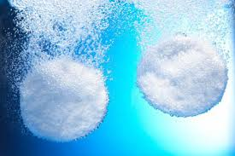
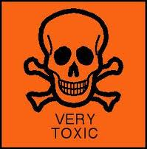
Chemical Properties
chemical property - any characteristic that allows a substance to become something new
Examples:
flammability - the ability of a substance to burn
toxicity
reactivity - the ability of a substance to combine with another substance (or break down into two or more substances) and form something new
combustibility – the ability to explode

Slide 3
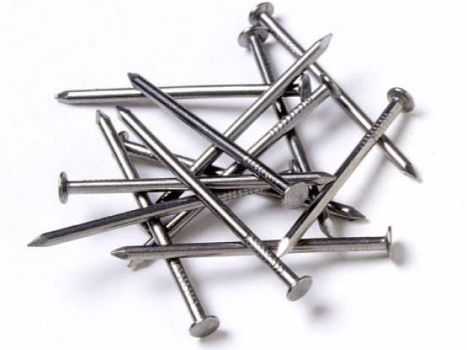
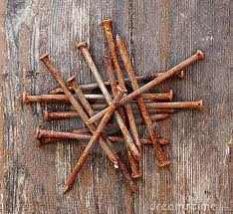
Physical vs. Chemical Properties
Physical Properties
Chemical Properties
observable ANYTIME
do NOT change the substance
ONLY observable when attempting to change the substance into something new, always present

Slide 4
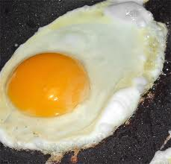
Chemical Change
chemical change - a change where the identity of matter does NOT stay the same
unlike physical changes, chemical changes form new substances & are not easily reversed
Examples:
digestion
photosynthesis
paint drying
burning
rusting

Slide 5
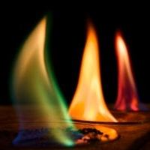
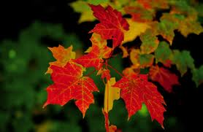
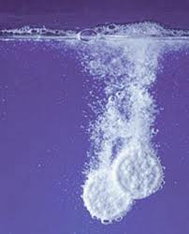
Evidences of Chemical Changes
release/absorption of energy
in the form of light, heat, or sound
formation of a gas or precipitate (solid formed from a solution)
not from a change of state
color changes
such as leaves changing color in the fall

Slide 6
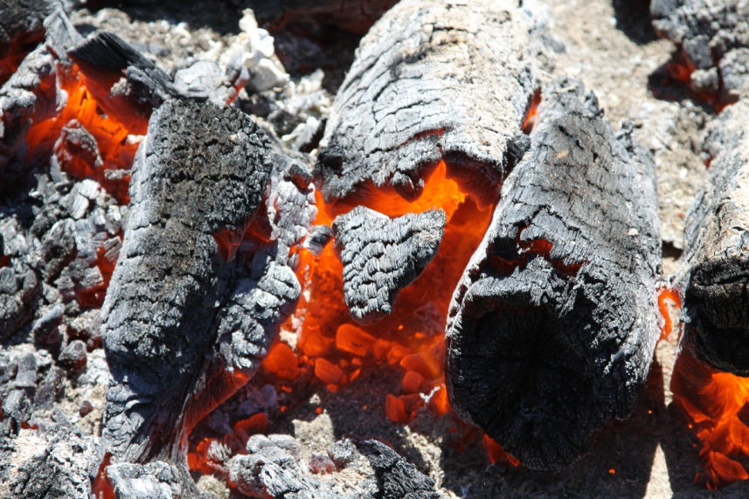
Physical vs. Chemical Changes
Physical Changes
Chemical Changes
more easily reversed
changes the composition (what the object is made up of) of the object
NOT easily reversed

