Slide 1
Unit 4 Waves
Ch. 21 Sec. 3 & 4
Music

Slide 2
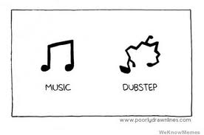
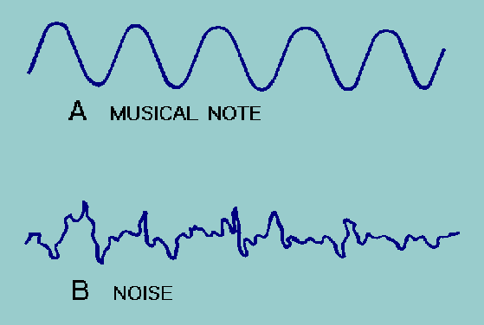
Music
music - a group of sounds w/ a regular pattern
noise - a group of sounds w/ no pattern
sound quality - result of the blending of several pitches through interference (gives an instrument it’s tone that makes us recognize it)

Slide 3
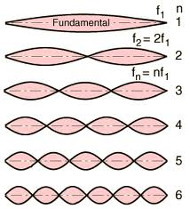
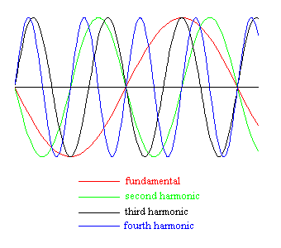
Sound & Frequency
Natural Frequency
Fundamental Frequency
natural frequency - frequency at which an object vibrates
depends on size, shape, & material of the object
musical instruments use the natural frequency of objects to make different notes
fundamental frequency - the lowest frequency produced by an object
multiples of the fundamental frequency produce higher frequency waves called overtones

Slide 4
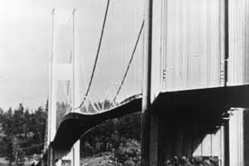
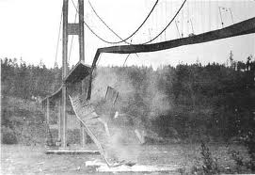
Resonance
resonance – a phenomenon that occurs when two objects naturally vibrate at the same frequency
the sound produced by one object causes the other object to vibrate

Slide 5
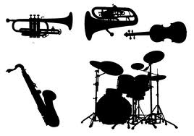
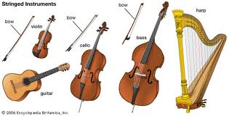
Musical Instruments
Musical Instruments
❶ Strings
musical instrument - device that produces music
3 types: string, percussion, & woodwind/brass
string instruments - produce music when strings vibrate
most amplify sound by using a hollow chamber called a resonator
ex. guitar, violin, piano

Slide 6
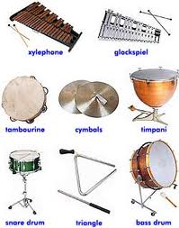
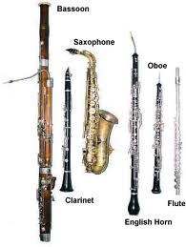
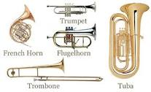
Musical Instruments
❷ Percussion
❸ Brass/Woodwind
percussion instruments - produce music when struck
ex. drum, triangle, tambourine
brass/woodwind instruments - produce music when the length of an air column is changed
ex. clarinet (w), flute (w), trumpet (b), tuba (b)

Slide 7
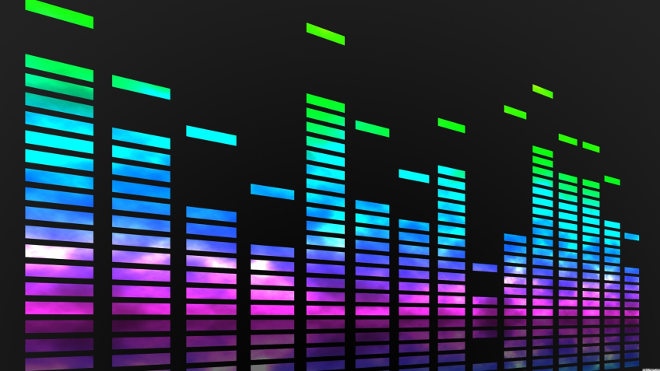
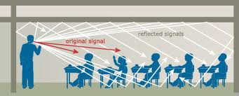
Beats & Reverberation
beats - interference that occurs when two notes are close in frequency
reverberation - repeated echoes of sound
the right amount of reverberation is important in concert halls and auditoriums

