Slide 1
Classifying Matter: Compounds, Mixtures, & Solutions

Slide 2
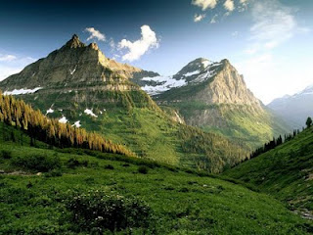
Elements Combine = Compounds
Few elements found in nature are found alone; most elements are found combined with other elements as compounds

Slide 3
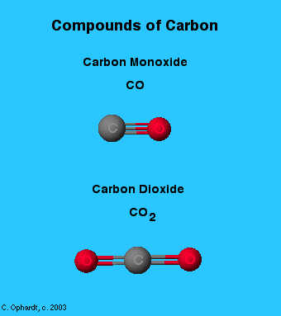
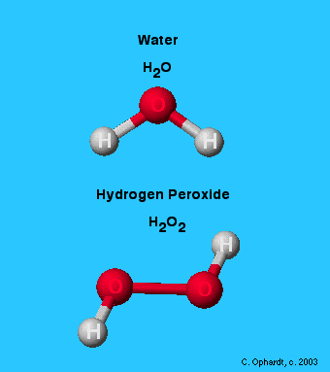
Compounds
compound - pure substance composed of two or more elements that are chemically combined
made of elements in a specific ratio that is always the same
have a chemical formula
can only be separated by
chemical means only (NOT physically)

Slide 4
Compounds
a compound can be formed when atoms from two or more elements are present
atoms must react or undergo a chemical change with one another to join
the compound is a new pure substance that is different from the elements that reacted to form it

Slide 5
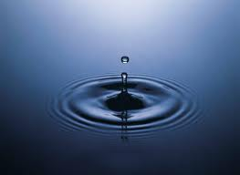
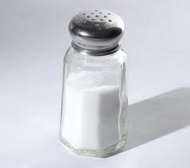
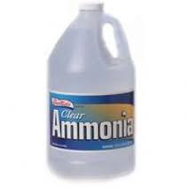
Properties of Compounds
Each compound has its own unique set of physical properties such as boiling point, melting point, density and color.
Compounds can also be identified by chemical properties
Same molecule throughout (appear to be uniform)
Some compounds can be broken down into elements through chemical changes

Slide 6
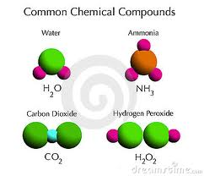
Common Compounds

Slide 7
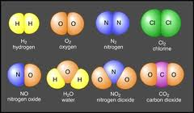
Molecules vs. Compounds
All compounds are molecules but not all molecules are compounds.
Molecules
Compounds

Slide 8
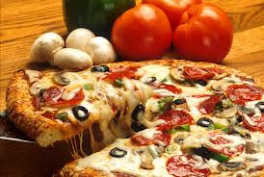
Pizza!
Write out your favorite pizza recipe.
Don’t forget the ingredients for the crust!
What happens if you don’t like one of the ingredients that is on a pizza, or in a salad, or in a party mix?

Slide 9
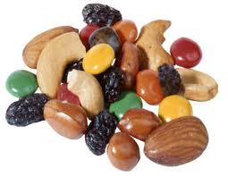
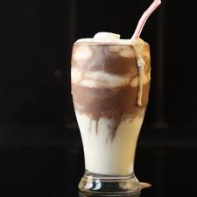
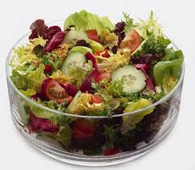
Mixtures
mixture - combination of two or more pure substances that are not chemically combined.
substances held together by physical forces, not chemical
NO chemical change takes place
each item retains its properties in the mixture
can be separated physically

Slide 10
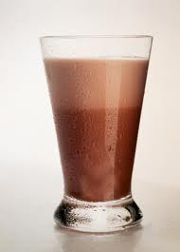
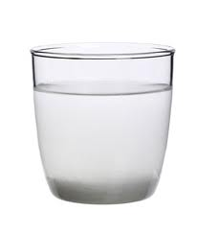
2 Types of Mixtures
Homogeneous Mixture
Heterogeneous Mixture
homogeneous mixture - has the same uniform appearance and composition throughout.
commonly referred to as solutions
heterogeneous mixture - consists of visibly different substances or phases.
NOT uniform throughout

Slide 11
Mixtures vs. Compounds
Mixtures vs. Compounds
1. Components are elements, compounds, or both | 1. Components are elements
2. Components keep their original properties | 2. Components lose their original properties
3. Separated by physical means | 3. Separated by chemical means
4. Formed using varying amounts of each substance in the mixture | 4. Formed using a set ratio of components
5. Examples: Air, Sea Water, Rocks | 5. Examples: Water, Carbon Dioxide, Magnesium Oxide, Sodium Chloride

Slide 12
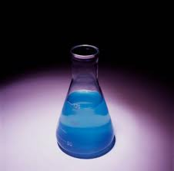
Solutions
solution - a mixture that appears to be a single substance
contains particles from 2 or more substances
described as homogeneous solutions because they have the same appearance and properties throughout the mixture

Slide 13
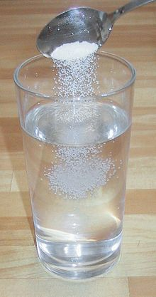
Solutions
made by dissolving
the solute is the substance or matter being dissolved or is soluble (able to be dissolved) in the solvent
the solvent is the substance into which the solute is dissolved

Slide 14
Can you identify the following?
You will be shown a series of photos. Tell if each photo represents an item composed of an element, compound, or mixture.
Review:
An element contains just one type of atom.
A compound contains two or more different atoms joined together.
A mixture contains two or more different substances that are only physically joined together, not chemically.
A mixture can contain both elements and compounds.

Slide 15
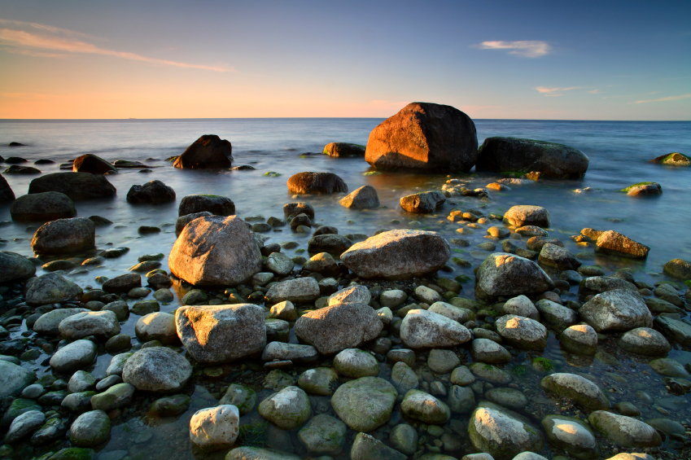
Element, Compound, or Mixture?
Rocks

Slide 16
Element, Compound, or Mixture?
Rocks

Slide 17
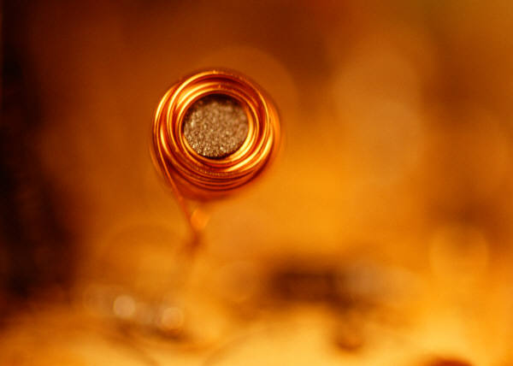
Element, Compound, or Mixture?
Copper

Slide 18
Element, Compound, or Mixture?
Copper
Cu

Slide 19
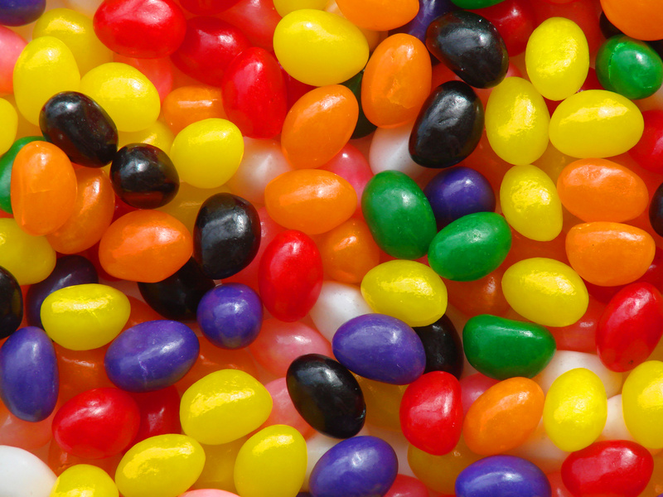
Element, Compound, or Mixture?
Jelly Beans

Slide 20
Element, Compound, or Mixture?
Jelly Beans

Slide 21
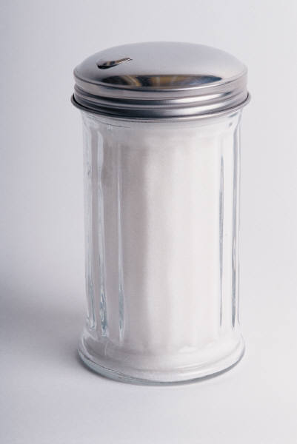
Element, Compound, or Mixture?
Table Sugar

Slide 22
Element, Compound, or Mixture?
Table Sugar
C₁₂H₂₂O₁₁

Slide 23
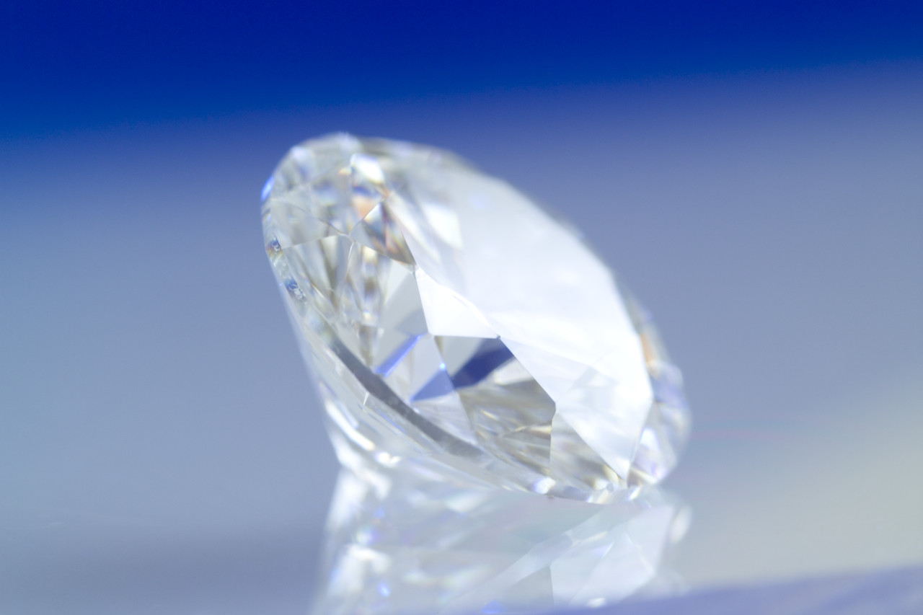
Element, Compound, or Mixture?
Diamond

Slide 24
Element, Compound, or Mixture?
Diamond
C

Slide 25
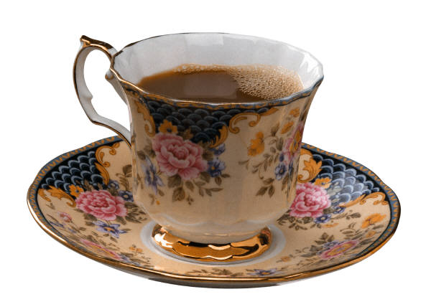
Element, Compound, or Mixture?
Tea

Slide 26
Element, Compound, or Mixture?
Tea

Slide 27
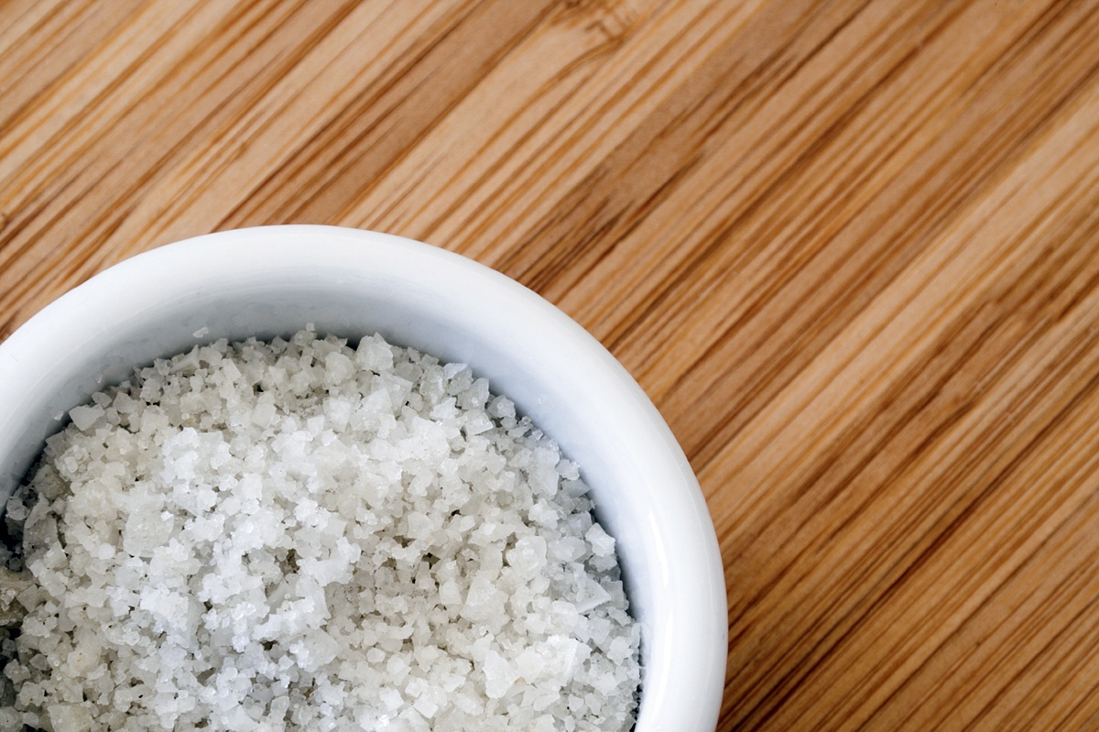
Element, Compound, or Mixture?
Salt

Slide 28
Element, Compound, or Mixture?
NaCl
Salt

Slide 29
Element, Compound, or Mixture?
Neon Gas

Slide 30
Element, Compound, or Mixture?
Ne
Neon Gas

Slide 31
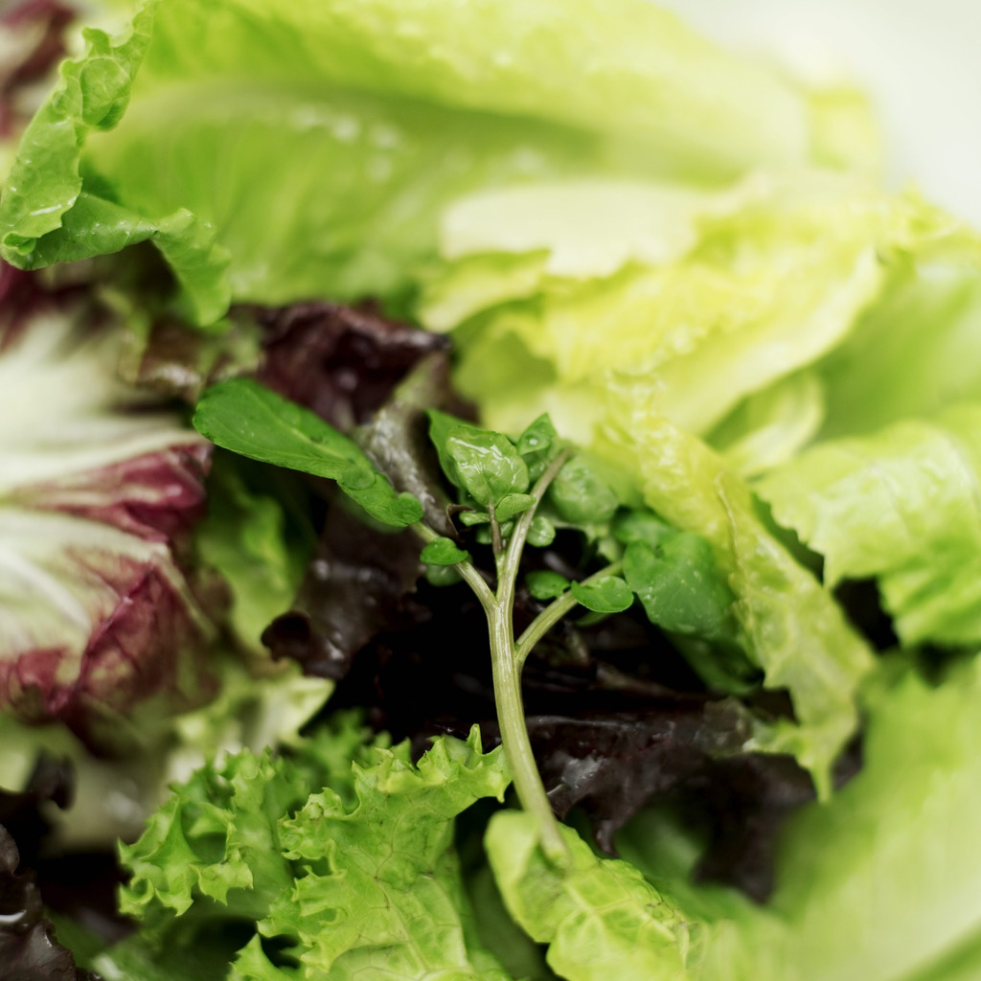
Element, Compound, or Mixture?
Salad

Slide 32
Element, Compound, or Mixture?
Salad

Slide 33
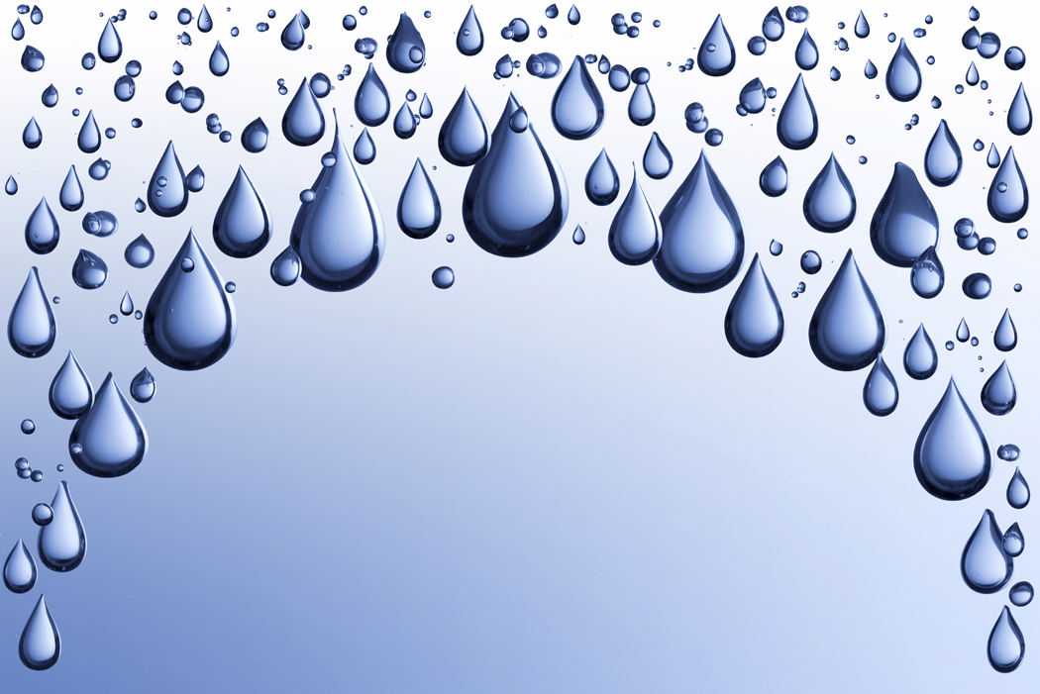
Element, Compound, or Mixture?
Pure Water

Slide 34
Element, Compound, or Mixture?
Pure Water
H₂O

Slide 35
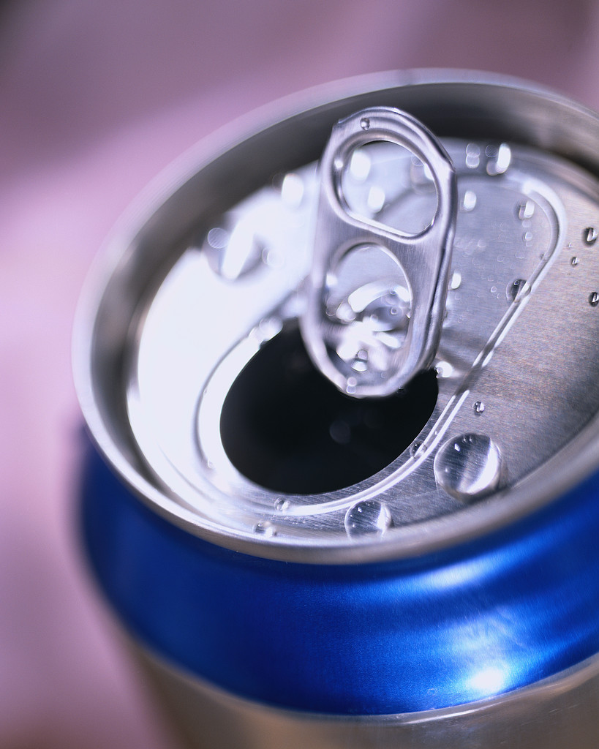
Element, Compound, or Mixture?
Aluminum

Slide 36
Element, Compound, or Mixture?
Aluminum
Al

Slide 37
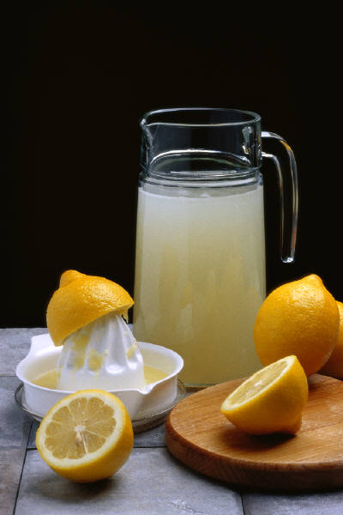
Element, Compound, or Mixture?
Lemonade

Slide 38
Element, Compound, or Mixture?
Lemonade

Slide 39
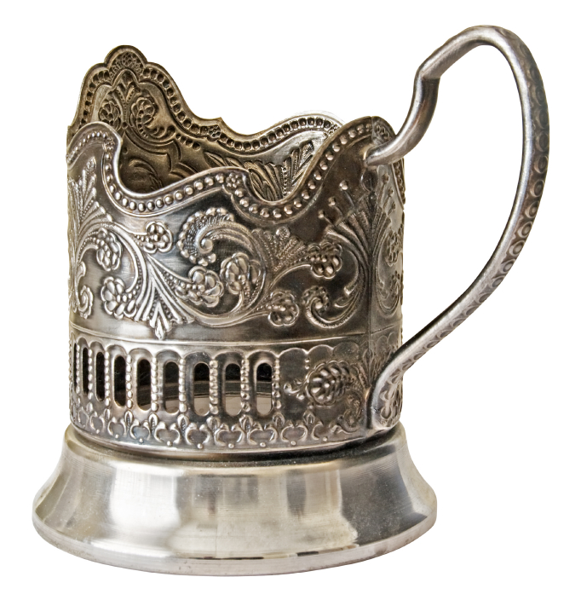
Element, Compound, or Mixture?
Silver

Slide 40
Element, Compound, or Mixture?
Silver
Ag

Slide 41
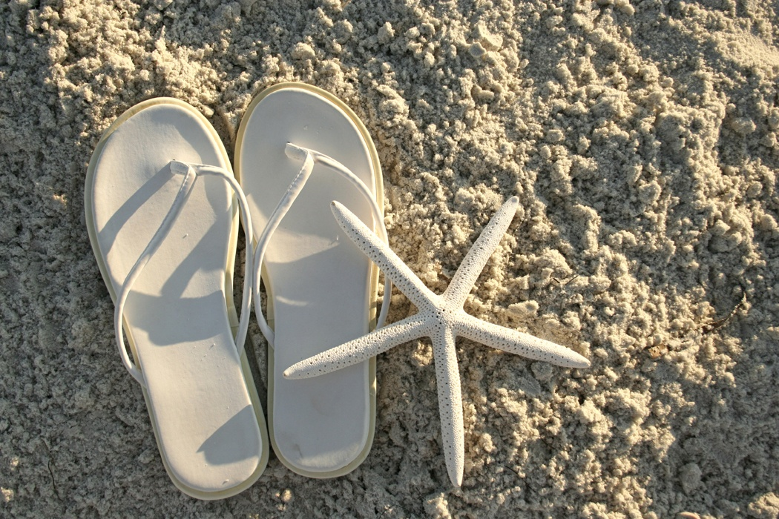
Element, Compound, or Mixture?
Sand

Slide 42
Element, Compound, or Mixture?
Sand

Slide 43
