Slide 1
Ions & Isotopes
Chapter 11
Section 2

Slide 2
Reminder…
Atoms have a neutral charge because the # of
protons = electrons

Slide 3
Charge of An Atom
BrainPOP
Ions
IF… # of protons = # of electrons
the atom becomes an ION
ion – charged particle that forms when an atom or group of atoms gains or loses one or more electrons

Slide 4
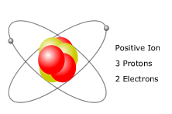
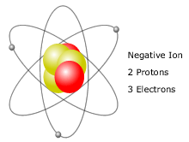
Charge of An Atom
If # protons > # electrons = positive charge
atom loses electron
CATION
If # protons < # electrons = negative charge
atom gains electron
ANION

Slide 5
Ions
CATION (+)
ANION (-)
$$Ca−1e− → Ca+$$
$$Ca−2e− → Ca2+$$
$$Ca−3e− → Ca3+$$
$$Ca+1e− → Ca−$$
$$Ca+2e− → Ca2−$$
$$Ca+3e− → Ca3−$$

Slide 6
Are All Atoms of an Element the Same?
BrainPOP
Isotopes
Not Necessarily!
Ions – unequal # of protons and electrons
Isotopes – unequal # of protons and neutrons
isotope – atoms with the same number of protons (same element) but with different numbers of neutrons (different masses)
In an isotope:
# of protons always remains the same
# of neutrons changes

Slide 7
Looks of an Isotope
Proton
Proton
Neutron
Electron
Electron
This is a Hydrogen Atom
This is a Hydrogen Atom Isotope
The isotope has 2 particles which means it has greater mass.

Slide 8
Properties of Isotopes
each element has a limited number of isotopes that occur naturally
isotopes share almost all of the same physical and chemical characteristics
example: oxygen isotopes are colorless, odorless gases at room temperature (physical)

Slide 9
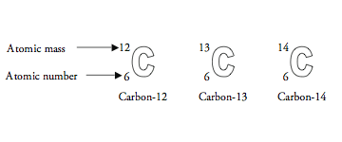
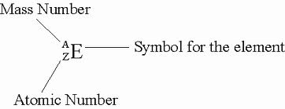
How Can We Tell One Isotope from Another?
each element has a mass number which identifies the isotope of the element.
mass number = protons + neutrons in an atom
mass numbers are typically not found on the periodic table

Slide 10
Naming Isotopes
Proton
Proton
Neutron
Electron
Electron
There is 1 proton and 0 neutrons so the name of this atom is Hydrogen-1
There is now 1 proton AND 1 neutron so the name changes to Hydrogen-2

Slide 11
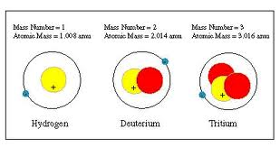
Atomic Mass vs Mass Number
Atomic Mass
Mass Number
atomic mass – the average mass of an atom
average takes into consideration all isotopes for an atom
decimal because it is an average of masses
mass number – the sum of the numbers of protons and neutrons in the nucleus of an atom
whole number because it is the exact summation of protons and neutrons
rounded atomic mass

