Slide 1
Unit 2 Force & Motion
Ch 6 Sec 4
Gravity

Slide 2
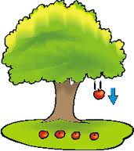
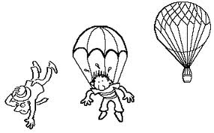
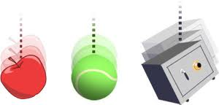
Gravity
gravity - the attractive force between two objects based on their masses
causes objects to fall with an acceleration of 9.8 m/s²
all matter is affected by gravity
all objects experience an attraction toward other objects
usually, the force is too small to cause a force large enough to move objects toward each other

Slide 3
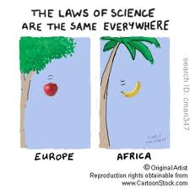
Law of Universal Gravitation
Law of Universal Gravitation: all objects in the universe attract each other through gravitational force
size of the force depends on the masses of the objects and the distance between the objects

Slide 4
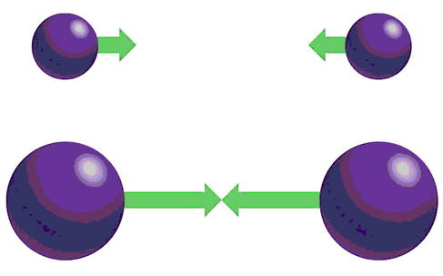
Gravitational Force: Effect of Mass
gravitational force between objects increase as the masses of the objects increase
Gravitational force is small between objects that have small masses
Gravitational force is large when the mass of one or both objects is large
the moon has less mass than the Earth, so it has less gravitational force

Slide 5
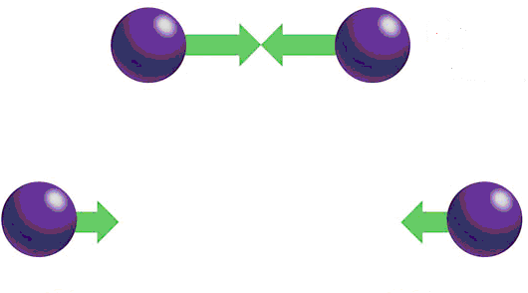
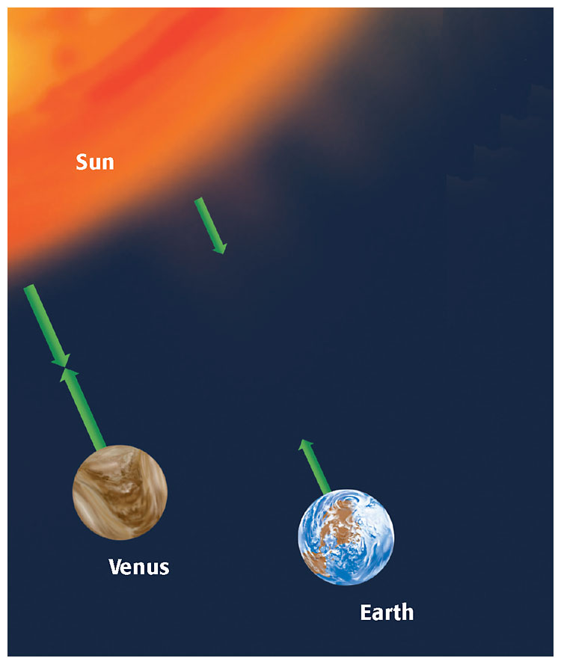
Gravitational Force: Effect of Distance
gravitational force between objects decreases as the distance between the objects increases
Gravitational force is strong when the distance between two objects is small
Gravitational force is weak when the distance between two objects is large
Venus and Earth have approximately the same mass. But because Venus is closer to the sun, the gravitational force between Venus and the sun is greater than the gravitational force between Earth and the sun.

Slide 6
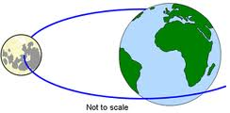
Earth’s Gravitational Force
Earth has a large mass, so it has a large gravitational force
Earth’s gravitational force pulls everything toward the center of the Earth

Slide 7
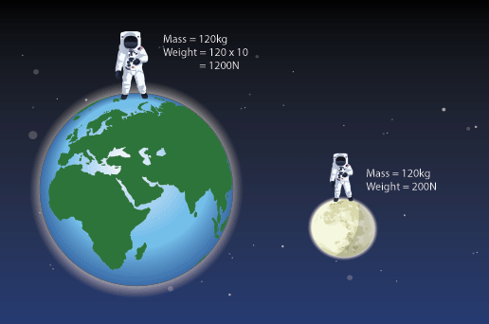
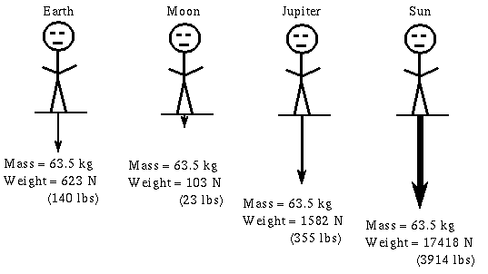
Weight
weight - a measure of gravitational force on an object
value changes depending on location in universe
Mass vs. Weight:
mass is the amount of matter in an object.
weight is the gravitational force pulling the mass
weight is measured in Newtons, while mass is measured in grams

Slide 8
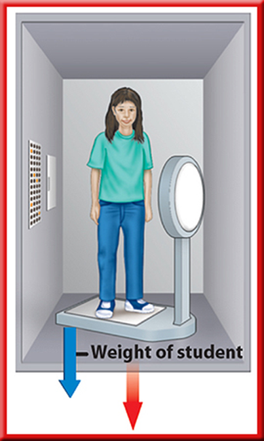
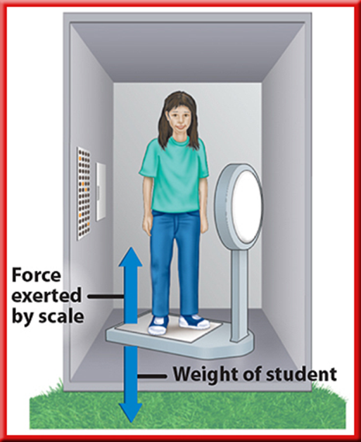
Weightlessness
an object is in free fall when gravity is the only force acting on it (no friction, no air resistance, etc.) - when a space shuttle orbits Earth, it & all of the objects inside are in free fall
weightlessness - when the weight of an object seems to be zero during a free fall (not actually weightless because gravity is still pulling on it)

Slide 9
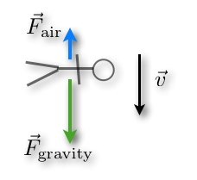
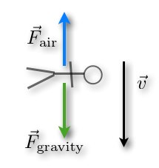
Terminal Velocity
terminal velocity – the constant velocity of a falling object when the force of air resistance is equal to the force of gravity
What is the net force of a skydiver who reaches terminal velocity?

