Slide 1
Ch. 10 Thermal Energy
Sec. 2
Heat

Slide 2
Heat
heat - thermal energy that is transferred from 1 object to another of a different temp.
thermal energy always moves from warmer to cooler objects
thermal energy is transferred in 3 ways…
1) conduction
2) radiation
3) convection

Slide 3
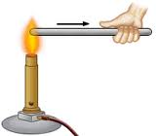
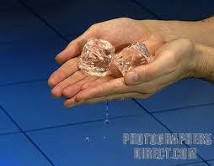
Conduction
conduction - transfer of heat by direct contact
particles of 1 substance collide w/ particles of another
occurs most easily in solids where particles are close together & thus, collide more
ex. heat from your hand transfers to an ice cube you are holding

Slide 4
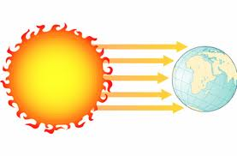
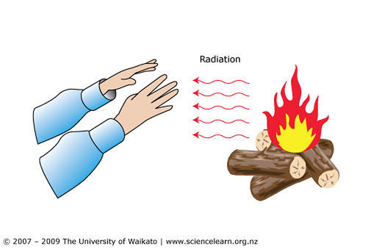
Radiation
radiation - transfer of heat by electromagnetic waves
can occur in empty space, solids, liquids, or gases
warm objects emit more radiation than cooler objects
ex. heat from a fire transfers to your nearby skin

Slide 5
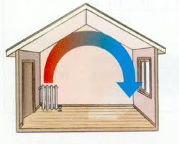
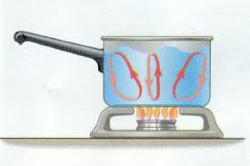
Convection
convection - transfer of thermal energy by the movement of molecules through a substance
occurs in liquids & gases because molecules move more easily
ex. the water molecules warming at the bottom of a pot move around carrying their energy w/ them

Slide 6
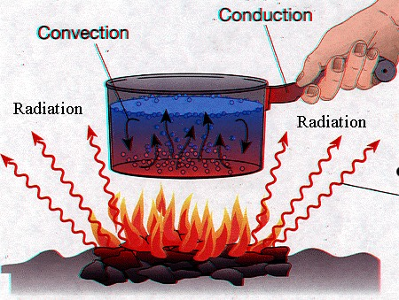
3 Types of Thermal Energy Transfer

Slide 7
Transferring Heat
conductor - material that easily transfers heat
good conductors = metals such as copper
insulator - material that doesn’t easily transfer heat
good insulators = gases & liquids
specific heat - the amount of heat needed to raise 1 kg of a substance 1°C
high specific heat = more difficult to heat up
ex. ocean has higher specific heat than sand

