Slide 1
Unit 4 Waves
Properties of Light

Slide 2
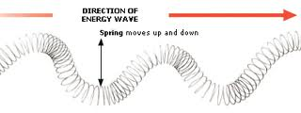
Reminder…
a wave is a disturbance that transfers energy

Slide 3
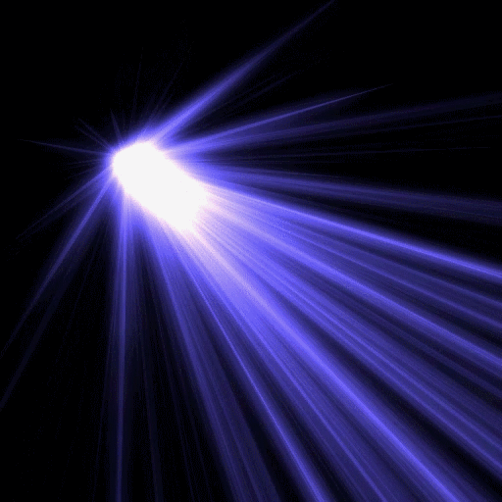
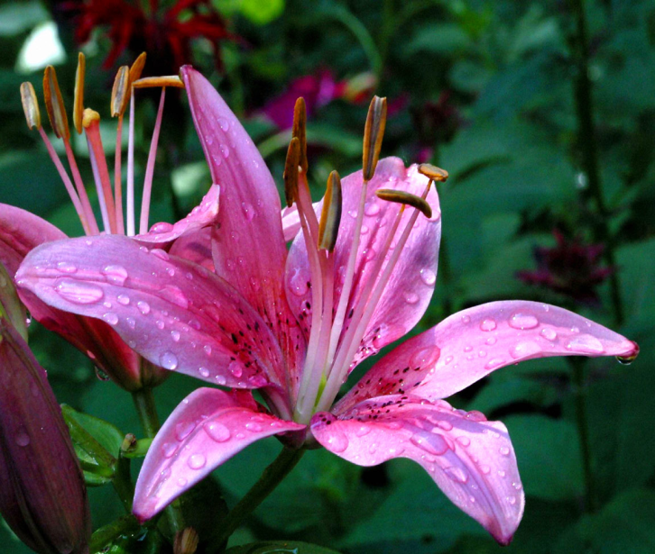
Light
light ray - a narrow beam of light that travels in a straight line
light sources give off rays in all directions
like all EM. waves, light does not need a medium to travel
most objects do not give off light & thus, are only visible when they reflect light
when light strikes an object… light waves are absorbed, reflected, and/or transmitted (pass through)
ALL objects reflect & absorb SOME light waves

Slide 4
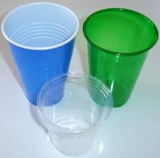
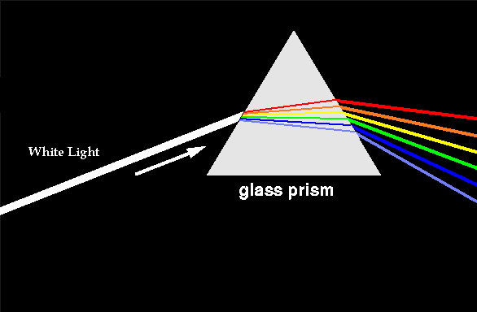
Light & Matter
opaque - material through which NO light passes - cannot see through it
ex. concrete & blue jeans
translucent - material through which SOME light passes - can see through it, but image is not clear
ex. wax paper & frosted glass
transparent - material through which ALMOST ALL light passes - can see through it clearly
ex. glass & clear plastic
white light is made of light waves with different wavelengths = different colors (ROYGBIV)

Slide 5
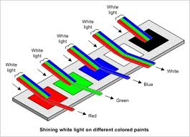
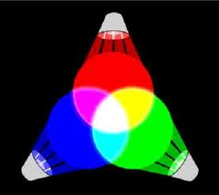
Color
color - the visual effect of reflected light waves
white = ALL wavelengths reflected
absorbs no light
black = NO wavelengths reflected
absorbs all light
primary light colors - the 3 colors of light that can be used to make all others - include red, blue, & green
ex. red light + green light = yellow light

Slide 6
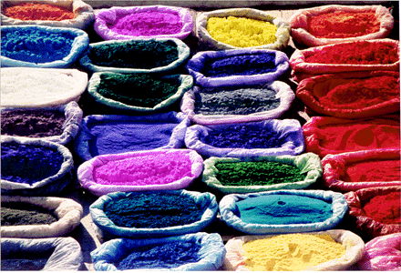
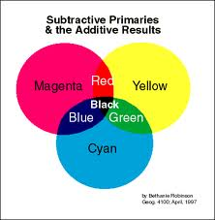
Pigments
pigments - materials that are used to change the color of objects
mixing pigments does not result in the same colors as mixing light does
ex. red light + green light = yellow light
ex. red pigment + green pigment = brown pigment
primary pigment colors - the three colors of pigment that can be used to make all colors of pigment
include magenta, cyan, & yellow

Slide 7
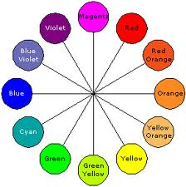
Pigments
each primary pigment color results when a pigment absorbs a primary light color
primary pigment color = white light - one primary light color
ex. cyan = white light – red
BG (cyan) = RBG – R
w/ pigments, the absorption of light, not just its reflection, determines the color you see

Slide 8
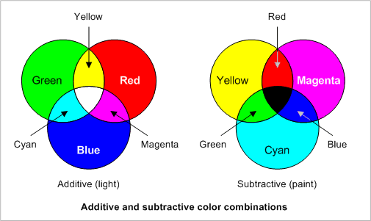
Light vs. Pigments

